Slide 1

Agentic workflow with SpringAI
Revolutionizing AI Solutions with Seamless Integration
Vikas Malik
April 19, 2025

Slide 2

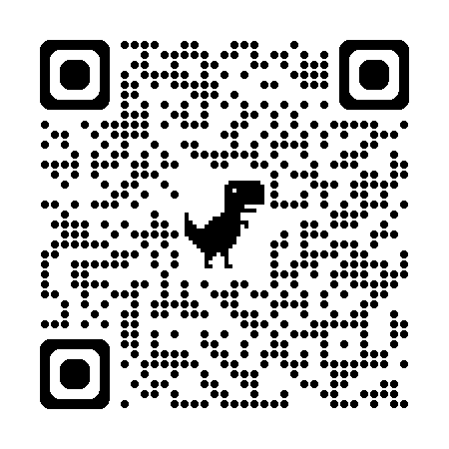
Delhi NCR Jug
https://github.com/delhijug/meetups#

Slide 3
Introduction to AgenticAI
Act autonomously: make decisions, and take actions minimal human intervention
Pursue Complex Goals
Adapt to changing Environment

Slide 4
Introduction to SpringAI
Spring AI addresses the fundamental challenge of AI integration
Connecting your enterprise Data and APIs with the AI Models

Slide 5
Features of SpringAI
Chat Completion
Embedding
Text to Image
Audio Transcription
Text to Speech
Moderation

Slide 6
Agentic Fundamental Patterns
Chain Workflow
Parallelization Workflow
Routing Workflow
Orchestrator-Workers
Evaluator-Optimizer

Slide 7
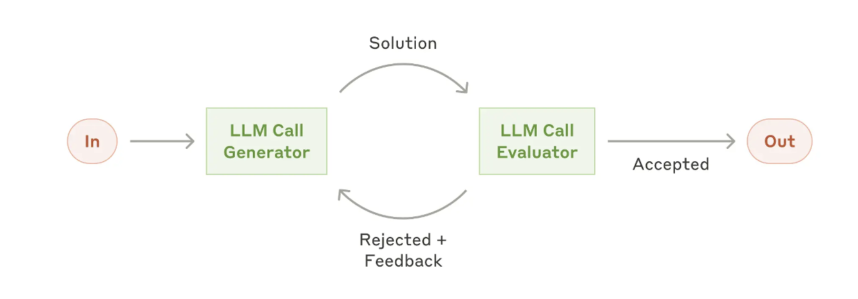
Technical Architecture: Evaluator-Optimizer

Slide 8
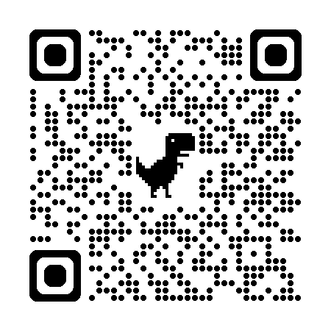

Demo
https://github.com/vikmalik/demos/tree/main/workshop

Slide 9

Questions

Slide 10
References
https://spring.io/projects/spring-ai
https://docs.spring.io/spring-ai/reference/api/chatclient.html
https://spring.io/blog/2025/01/21/spring-ai-agentic-patterns
https://docs.spring.io/spring-ai/reference/api/vectordbs.html
https://docs.spring.io/spring-ai/reference/api/tools.html
https://docs.spring.io/spring-ai/reference/api/mcp/mcp-overview.html

Slide 11


Thanks!
LinkedIn: vikasmalik21
X: @_vikasM

